Slide 1
TENNESSEE 4-H MEAT JUDGING
PRESENTATION
Beef Hindquarter Retail ID
Gary T. Rodgers
Extension Agent II
Hardeman County

Slide 2
Beef Retail Cuts- Hindquarter
Notice that a picture will notify students when the Primal Cut Region changes. Primal Cut Name is underlined in red.
Each slide also has a button that, when clicked will show some features of the cut. To go back to the previously viewed slide, click the button.
Features

Slide 3
Retail Cut Identification
Beef Cuts
Hindquarter
Loin
Short Loin
Sirloin
Round
Flank

Slide 4
Retail Cuts of the Beef Hindquarter
Primal | Retail Cut Name
Loin | Beef Loin Top Loin Steak, Bnls
 | Beef Loin T-bone Steak
 | Beef Loin Porterhouse Steak
 | Beef Loin Top Sirloin Steak
 | Beef Loin Tenderloin Steak
Flank | Beef Flank Steak
Round | Beef Round Steak
 | Beef Round Top Round Roast
 | Beef Round Top Round Steak
 | Beef Round Bottom Round Roast
 | Beef Round Bottom Round Steak
 | Beef Round Eye Round Roast
 | Beef Round Eye Round Steak
 | Beef Round Tip Roast
 | Beef Round Tip Steak
 | Beef Round Tip Roast-Cap Off
 | Beef Round Tip Steak-Cap Off
Various | Beef Cubed Steak
 | Beef For Stew
 | Ground Beef

Slide 5
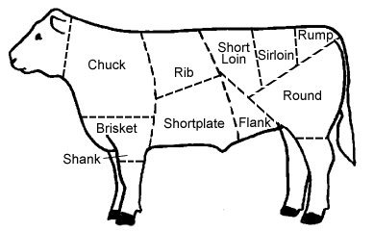
Retail Cuts of the Beef Hindquarter
Loin

Slide 6
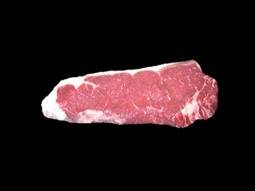
17.
Beef Loin Top Loin Steak, BNLS –
B, H, 55, St, D
Features
Notes:
B,H,55,ST,D
BEEF LOIN TOP LOIN STEAK, BONELESS
Top loin muscle(i. e. Larger muscle from T-bone or Porterhouse)

Slide 7
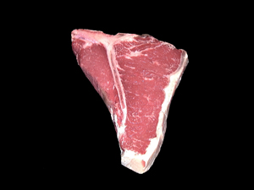
18.
Beef Loin T-Bone Steak – B, H, 49, St, D
Features
Notes:
B,H,49,ST,D
BEEF LOIN T-BONE STEAK
Contains the "T-shaped" bone which is the backbone and transverse process, Top Loin and Tenderloin; Tenderloin measures between 1/2"-1 1/4"

Slide 8
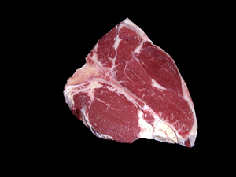
19.
Beef Loin Porterhouse Steak – B, H, 27, St, D
Features
Notes:
B,H,27,ST,D
BEEF LOIN PORTERHOUSE STEAK
Similar to T-bone; Tenderloin measures at least 1 1/4"; "Jump" muscle also present on top loin muscle

Slide 9
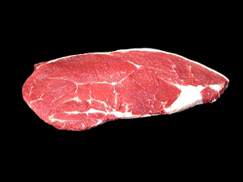
20.
Beef Loin Top Sirloin Steak – B, H, 57, St, D
Features
Notes:
B,H,57,ST,D
BEEF LOIN TOP SIRLOIN STEAK
Similar to other Beef Sirloin steaks but boneless; May notice "cap" type muscle as well

Slide 10
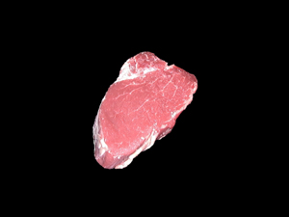
21.
Beef Loin Tenderloin Steak – B, H, 50, St, D
Features
Notes:
B,H,50,ST,D
BEEF LOIN TENDERLOIN STEAK
Semi-oval shaped steak cut from the tenderloin roast; 1-2" in thickness

Slide 12
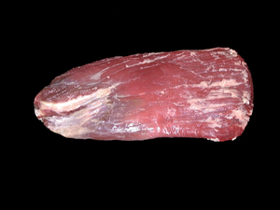
22.
Beef Flank Steak– B, D, 17, St, D/M
Features
Notes:
B,D,17,ST,D/M
BEEF FLANK STEAK
Boneless, flat cut containing muscle fibers that run the length of the cut; Very lean

Slide 14
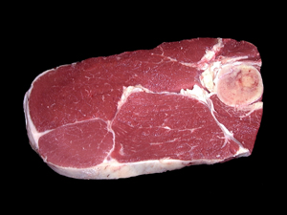
23.
Beef Round Steak – B, K, 33, St, M
Features
Notes:
B,K,33,ST,M
BEEF ROUND STEAK
Round leg bone present; Contains 3 major muscles-Top, Bottom and Eye

Slide 15
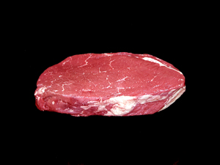
24.
Beef Round Top Round Roast –
B, K, 56, Ro, D
Features
Notes:
B,K,56,RO,D
BEEF TOP ROUND ROAST
Boneless cut containing the top(inside) muscle of the round

Slide 16
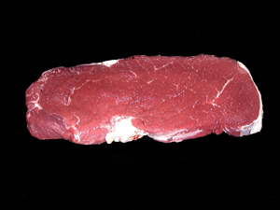
25.
Beef Round Top Round Steak –
B, K, 56, St, D
Features
Notes:
B,K,56,ST,D
BEEF TOP ROUND STEAK
Boneless cut containing the top(inside) muscle of the round; Usually cut 1" or less in thickness

Slide 17
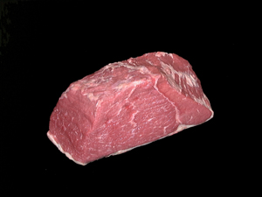
26.
Beef Round Bottom Round Roast –
B, K, 9, Ro, D/M
Features
Notes:
B,K,9,RO,M
BEEF BOTTOM ROUND ROAST
Thick, irregular shaped cut from the bottom(outside) of the round; Note a streak of fat separates a smaller muscle

Slide 18
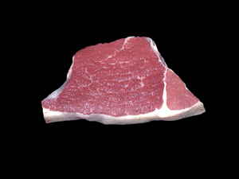
27.
Beef Round Bottom Round Steak –
B, K, 9, St, M
Features
Notes:
B,K,9,ST,M
BEEF BOTTOM ROUND STEAK
Irregular shaped steak from the bottom(outside) of the round; 1/2" thickness; Note a streak of fat separates a smaller muscle

Slide 19
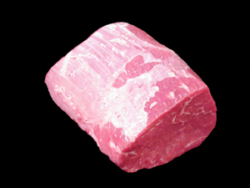
28.
Beef Round Eye Round Roast –
B, K, 16, Ro, D/M
Features
Notes:
B,K,16,RO,D/M
BEEF EYE ROUND ROAST
Roast cut from the eye round which is separated from the bottom round

Slide 20
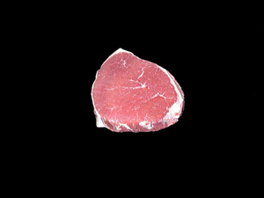
29.
Beef Round Eye Round Steak –
B, K, 16, St, D/M
Features
Notes:
B,K,16,ST,D/M
BEEF EYE ROUND STEAK
Steak cut from the eye round; Less than 1" thickness

Slide 21
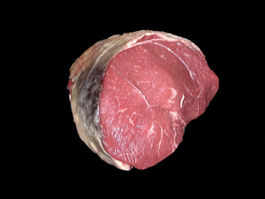
30.
Beef Round Tip Roast – B, K, 51, Ro, D/M
Features
Notes:
B,K,51,RO,D/M
BEEF ROUND TIP ROAST
Roast cut from the Round; Note the "cap" muscle of the sirloin

Slide 22
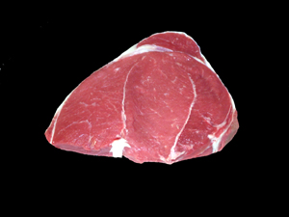
31.
Beef Round Tip Steak – B, K, 51, St, D
Features
Notes:
B,K,51,ST,D
BEEF ROUND TIP STEAK
Same structure as the Tip Roast but cut about 1" thickness

Slide 23
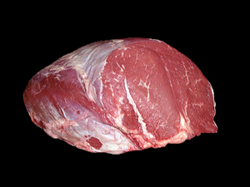
32.
Beef Round Tip Roast Cap-off–
B, K, 52, Ro, D/M
Features
Notes:
B,K,52,RO,D/M
BEEF ROUND TIP CAP-OFF ROAST
Roast cut from the round; Note the "cap" muscle of the sirloin is removed

Slide 24
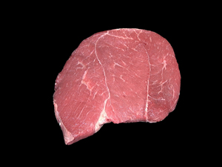
33.
Beef Round Tip Steak Cap-off–
B, K, 52, St, D
Features
Notes:
B,K,52,ST,D
BEEF ROUND TIP CAP-OFF STEAK
Steak cut from the round; Note the "cap" muscle of the sirloin is removed

Slide 25
Beef Various Cuts

Slide 26
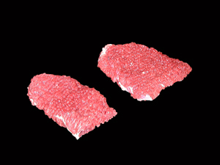
34.
Beef Various, Cubed Steak–
B, Q, 14, St, D/M
Features
Notes:
B,Q,14,ST,D/M
BEEF CUBED STEAK
Generally square or rectangular shaped cut; Machine tenderized look

Slide 27
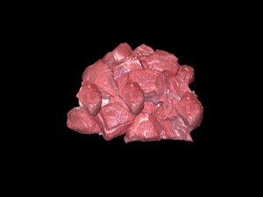
35.
Beef Various, Beef for Stew– B, Q, 68, -, M
Features
Notes:
B, Q, 68, -, M
BEEF FOR STEW
Lean pieces of beef cut into cubes

Slide 28
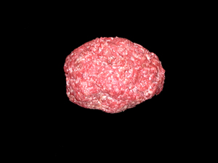
36.
Beef Various, Ground Beef– B, Q, 78, -, D
Features
Notes:
B,Q,78,-,D
GROUND BEEF
Note color; Lean to fat ratios vary

Slide 29
Primal | Retail Cut Name | Cookery Method | Specie | Primal | Retail Name | Type | Cookery Method
Loin | Beef Loin Top Loin Steak, Bnls | Dry | B | H | 55 | St | D
 | Beef Loin T-bone Steak | Dry | B | H | 49 | St | D
 | Beef Loin Porterhouse Steak | Dry | B | H | 27 | St | D
 | Beef Loin Top Sirloin Steak | Dry | B | H | 57 | St | D
 | Beef Loin Tenderloin Steak | Dry | B | H | 50 | St | D
Flank | Beef Flank Steak | Dry/Moist | B | D | 17 | St | D/M
Round | Beef Round Steak | Moist | B | K | 33 | St | M
 | Beef Round Top Round Roast | Dry | B | K | 56 | Ro | D
 | Beef Round Top Round Steak | Dry | B | K | 56 | St | D
 | Beef Round Bottom Round Roast | Dry/Moist | B | K | 9 | Ro | D/M
 | Beef Round Bottom Round Steak | Moist | B | K | 9 | St | M
 | Beef Round Eye Round Roast | Dry/Moist | B | K | 16 | Ro | D/M
 | Beef Round Eye Round Steak | Dry/Moist | B | K | 16 | St | D/M
 | Beef Round Tip Roast | Dry/Moist | B | K | 51 | Ro | D/M
 | Beef Round Tip Steak | Dry | B | K | 51 | St | D
 | Beef Round Tip Roast-Cap Off | Dry/Moist | B | K | 52 | Ro | D/M
 | Beef Round Tip Steak-Cap Off | Dry | B | K | 52 | St | D
Various | Beef Cubed Steak | Dry/Moist | B | Q | 14 | St | D/M
 | Beef For Stew | Moist | B | Q | 68 |  | M
 | Ground Beef | Dry | B | Q | 78 |  | D

Slide 30
TENNESSEE 4-H MEAT JUDGING
ACTIVITY GUIDELINES
Credit for the photos used in the Retail Identification portion of this presentation goes to:
  Texas AgriLife Extension Service and the AggieMeat website (aggiemeat.tamu.edu)
  University of Kentucky Agripedia Meats ID page

Slide 31
Additional Resources
Texas A & M Meat Science Department http://meat.tamu.edu/extension.html
  Has judging classes as well as retail ID practice
  Note that some of the retail ID cuts may not be included in the Tennessee 4-H list.
American Meat Science Association – 4-H Meat Judging
  Has information on National 4-H Contests
  Has links to several very good resources

Slide 32
Retail Cuts of the Beef Hindquarter
Next section will cover Pork Retail Cuts

Slide 33
Retail Cuts of the Beef Hindquarter
Loin

Slide 34
17.
Beef Loin Top Loin Steak, BNLS –
B, H, 55, St, D
Top Loin muscle
Notes:
B,H,55,ST,D
BEEF LOIN TOP LOIN STEAK, BONELESS
Top loin muscle(i. e. Larger muscle from T-bone or Porterhouse)

Slide 35
18.
Beef Loin T-Bone Steak – B, H, 49, St, D
Backbone
Tenderloin muscle
Top Loin muscle
Transverse process
Notes:
B,H,49,ST,D
BEEF LOIN T-BONE STEAK
Contains the "T-shaped" bone which is the backbone and transverse process, Top Loin and Tenderloin; Tenderloin measures between 1/2"-1 1/4"

Slide 36
19.
Beef Loin Porterhouse Steak – B, H, 27, St, D
Backbone
“Jump” muscle
Top Loin muscle
Tenderloin muscle
Transverse process
Notes:
B,H,27,ST,D
BEEF LOIN PORTERHOUSE STEAK
Similar to T-bone; Tenderloin measures at least 1 1/4"; "Jump" muscle also present on top loin muscle

Slide 37
20.
Beef Loin Top Sirloin Steak – B, H, 57, St, D
“Cap” muscle
Notes:
B,H,57,ST,D
BEEF LOIN TOP SIRLOIN STEAK
Similar to other Beef Sirloin steaks but boneless; May notice "cap" type muscle as well

Slide 38
21.
Beef Loin Tenderloin Steak – B, H, 50, St, D
Tenderloin muscle
Often referred to as Filet Mignon
Notes:
B,H,50,ST,D
BEEF LOIN TENDERLOIN STEAK
Semi-oval shaped steak cut from the tenderloin roast; 1-2" in thickness

Slide 40
22.
Beef Flank Steak– B, D, 17, St, D/M
Notice muscle fibers
Notes:
B,D,17,ST,D/M
BEEF FLANK STEAK
Boneless, flat cut containing muscle fibers that run the length of the cut; Very lean

Slide 42
23.
Beef Round Steak – B, K, 33, St, M
Top
Round leg bone
Eye
Bottom
Notes:
B,K,33,ST,M
BEEF ROUND STEAK
Round leg bone present; Contains 3 major muscles-Top, Bottom and Eye

Slide 43
24.
Beef Round Top Round Roast –
B, K, 56, Ro, D
Top Round generally has little external fat
Notes:
B,K,56,RO,D
BEEF TOP ROUND ROAST
Boneless cut containing the top(inside) muscle of the round

Slide 44
25.
Beef Round Top Round Steak –
B, K, 56, St, D
Top Round steak usually 1” thickness
Notes:
B,K,56,ST,D
BEEF TOP ROUND STEAK
Boneless cut containing the top(inside) muscle of the round; Usually cut 1" or less in thickness

Slide 45
26.
Beef Round Bottom Round Roast –
B, K, 9, Ro, D/M
Notice seam fat
Notes:
B,K,9,RO,M
BEEF BOTTOM ROUND ROAST
Thick, irregular shaped cut from the bottom(outside) of the round; Note a streak of fat separates a smaller muscle

Slide 46
27.
Beef Round Bottom Round Steak –
B, K, 9, St, M
Notice seam fat
Notes:
B,K,9,ST,M
BEEF BOTTOM ROUND STEAK
Irregular shaped steak from the bottom(outside) of the round; 1/2" thickness; Note a streak of fat separates a smaller muscle

Slide 47
28.
Beef Round Eye Round Roast –
B, K, 16, Ro, D/M
Coarse textured lean
Notes:
B,K,16,RO,D/M
BEEF EYE ROUND ROAST
Roast cut from the eye round which is separated from the bottom round

Slide 48
29.
Beef Round Eye Round Steak –
B, K, 16, St, D/M
Coarse textured lean
Notes:
B,K,16,ST,D/M
BEEF EYE ROUND STEAK
Steak cut from the eye round; Less than 1" thickness

Slide 49
30.
Beef Round Tip Roast – B, K, 51, Ro, D/M
“Cap” muscle
Notes:
B,K,51,RO,D/M
BEEF ROUND TIP ROAST
Roast cut from the Round; Note the "cap" muscle of the sirloin

Slide 50
31.
Beef Round Tip Steak – B, K, 51, St, D
“Cap” muscle
Notes:
B,K,51,ST,D
BEEF ROUND TIP STEAK
Same structure as the Tip Roast but cut about 1" thickness

Slide 51
32.
Beef Round Tip Roast Cap-off–
B, K, 52, Ro, D/M
“Cap” muscle removed
Notes:
B,K,52,RO,D/M
BEEF ROUND TIP CAP-OFF ROAST
Roast cut from the round; Note the "cap" muscle of the sirloin is removed

Slide 52
33.
Beef Round Tip Steak Cap-off–
B, K, 52, St, D
“Cap” muscle removed
Notes:
B,K,52,ST,D
BEEF ROUND TIP CAP-OFF STEAK
Steak cut from the round; Note the "cap" muscle of the sirloin is removed

Slide 53
Beef Various Cuts

Slide 54
34.
Beef Various, Cubed Steak–
B, Q, 14, St, D/M
Has “tenderized” look
Notes:
B,Q,14,ST,D/M
BEEF CUBED STEAK
Generally square or rectangular shaped cut; Machine tenderized look

Slide 55
35.
Beef Various, Beef for Stew– B, Q, 68, -, M
Small cubes of beef
To help remember cookery method(M), think of Beef Stew in liquid
Notes:
B, Q, 68, -, M
BEEF FOR STEW
Lean pieces of beef cut into cubes

Slide 56
36.
Beef Various, Ground Beef– B, Q, 78, -, D
Notice red color
To help remember cookery method(D), think of burgers on the grill
Notes:
B,Q,78,-,D
GROUND BEEF
Note color; Lean to fat ratios vary

